Slide 1
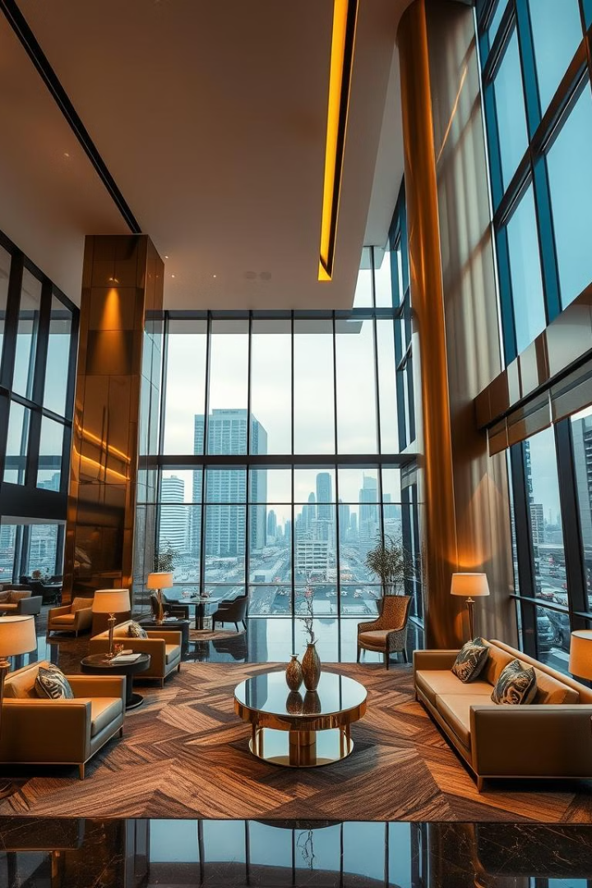
Hotel Booking Analysis
Data Insights and Business Recommendations
Prepared by : Ibrahim Ali

Slide 2
Introduction
This report analyzes hotel booking data to uncover trends, customer behavior, and factors influencing cancellations.
The insights derived will help inform pricing strategies, inventory management, and cancellation policies.

Slide 3
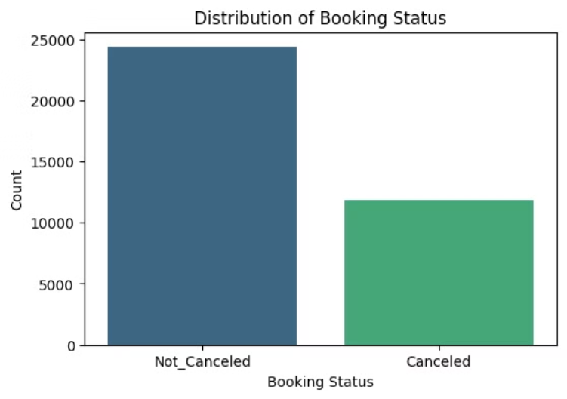
Target Distribution: Booking Status
Booking Status Distribution
Proportion of confirmed vs. canceled bookings
Key Insight
Significantly more confirmed bookings than canceled
Implications
Understanding the distribution is crucial for revenue and operational planning

Slide 4
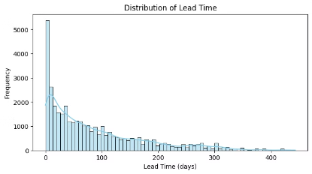
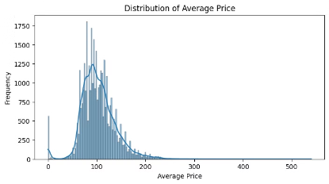
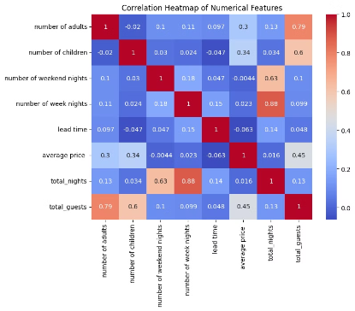
Numerical Features Analysis
Lead Time Insights
Average Price Insights
High last-minute bookings → Many customers book close to the stay date.
Right-skewed distribution: Most prices fall between 50-150, with a few high-value outliers.
Correlation Insights
Advance bookings exist → Likely for vacations or events.
Potential outliers: Prices above 300-500 could indicate luxury bookings or data anomalies.
Total guests strongly correlate with adults (0.79) and children (0.6).
Revenue opportunities → Use last-minute deals & early-bird discounts.
Common price range: Demand drops significantly after 150, suggesting price sensitivity.
Total nights and week nights have a high correlation (0.88).
Dynamic pricing → Adjust prices based on booking time.
Business impact: Focus on budget-friendly pricing, with a niche opportunity for premium services.
Average price moderately correlates with total guests (0.45).
Cancellation risks → Longer lead times may mean higher cancellation rates.
Lead time has little impact on price (-0.063).
Operational planning → Helps manage room availability & staffing efficiently.
Larger guest groups and longer stays influence pricing the most.

Slide 5
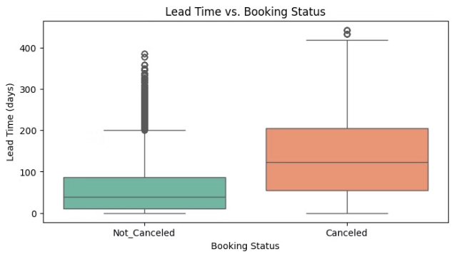
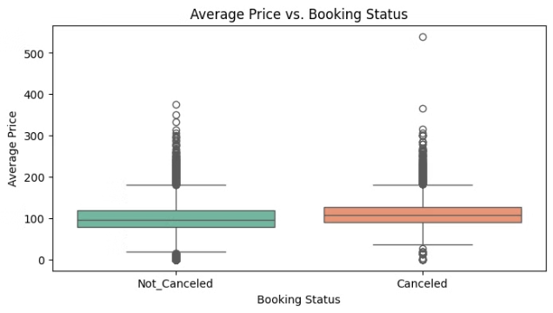
Compare numerical features with cancellation status
Lead time vs. booking status
Average price vs. booking status
Higher lead times are associated with more cancellations.
Price Influence on Cancellations → Higher prices might correlate with more cancellations.
Non-canceled bookings tend to have shorter lead times.
Cancellations show a wider spread, with many bookings made months in advance.
Budget-Conscious Customers → Lower-priced bookings tend to be completed more often.
Long lead times increase the likelihood of cancellations.
Revenue Strategy → Offering discounts or flexible pricing could reduce cancellations.
Segmentation Opportunities → Identify customer groups that book at different price points.
Cancellation Policies → Stricter policies for high-priced bookings may help reduce risks.

Slide 6
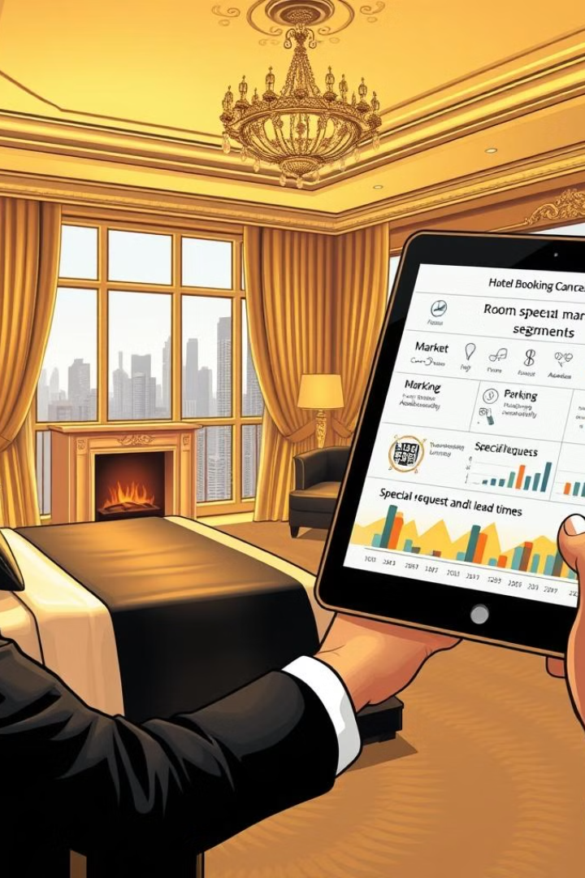
Insights from Categorical Features Analysis
Room Type → Some room types have higher cancellations.
Market Segment → Direct vs. third-party bookings affect cancellation rates.
Meal Type → Premium meal plans may reduce cancellations.
Parking Space → Availability influences booking decisions.
Special Requests → Customers with requests cancel less.
Lead Time → Longer lead times tend to have more cancellations.

Slide 7
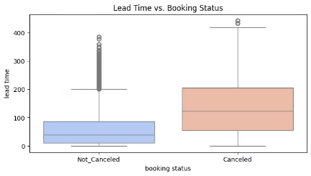
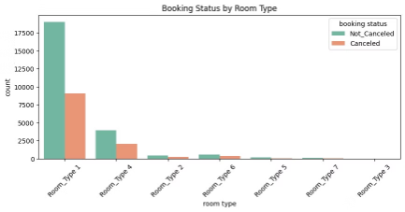
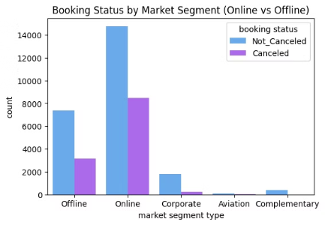
Key Business Questions
Longer lead time, higher cancellations?
Are certain room types or meal plans linked to higher cancellations?
Do online bookings cancel more often than offline?
Longer lead times tend to have higher cancellations.
Room Type & Cancellations:
Certain room types may have higher cancellation rates.
Online bookings may show a higher cancellation rate.
Canceled bookings show a higher median lead time.
Premium or luxury rooms could attract more cancellations due to higher costs.
Offline bookings tend to be more stable.
Customers booking far in advance may cancel due to changes in plans.
Meal Plan & Cancellations:
Short lead times often indicate confirmed stays with lower cancellation rates.
Some meal plans may be linked to higher cancellations.
Guests might prefer flexibility in dining and cancel when better options arise.

Slide 8
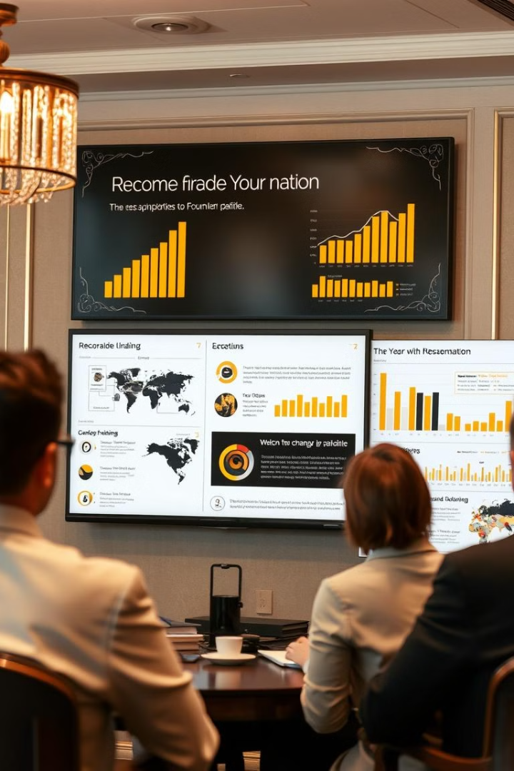
Conclusions
Booking Trends
Most bookings are confirmed, but longer lead times often lead to higher cancellations.
Lead Time & Pricing
Bookings made well in advance cancel more frequently.
Higher prices are linked with increased cancellations.
Operational Impact
Tailor cancellation policies and pricing strategies to balance revenue and risk.
Focus on guest segmentation for targeted promotions.

